Slide 1
運用優先權與無耐性之區塊鏈交易模型研究 A Study on Blockchain Transaction Models with Priority and Impatience
指导教授： 钟顺平 教授
研 究 生： 蔡怡翔
公元 2025 年 0 月 0 日

Slide 2
Outline
Motivation
System Model
Analytical Model
Numerical Results
Conclusions and Future Works

Slide 3
Outline
Motivation
System Model
Analytical Model
Numerical Results
Conclusions and Future Works

Slide 5
Motivation
Draws on examples from [10] to develop a queueing model for cross-chain transaction flows.
Two sequential queues: customer queue and block queue
Customer queue: waiting to be selected for block formation
Block queue: undergoing consensus
ON / OFF mechanism
Partial batch service
Capture realistic life
Non-preemptive priority
Impatience

Slide 6
Outline
Motivation
System Model
Analytical Model
Numerical Results
Conclusions and Future Works

Slide 7
Outline
Motivation
System Model
Analytical Model
Numerical Results
Conclusions and Future Works

Slide 8
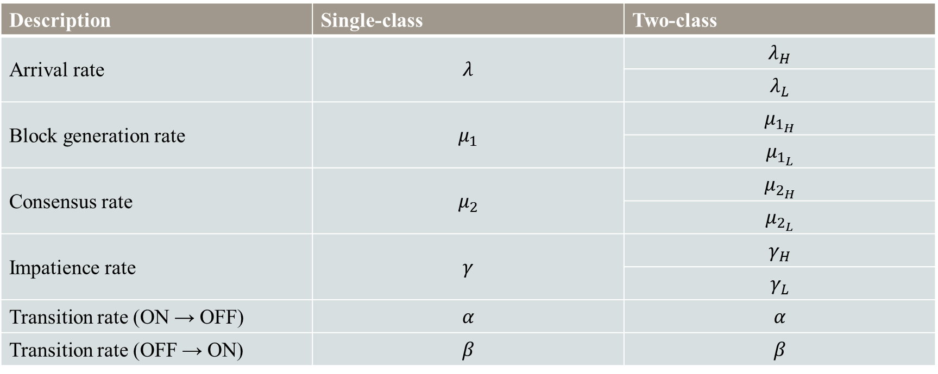
Analytical Model
Description | Single-class | Two-class
Arrival rate | $$λ$$ | $$λ_{H}$$
 |  | $$λ_{L}$$
Block generation rate | $$μ_{1}$$ | $$μ_{1_{H}}$$
 |  | $$μ_{1_{L}}$$
Consensus rate | $$μ_{2}$$ | $$μ_{2_{H}}$$
 |  | $$μ_{2_{L}}$$
Impatience rate | $$γ$$ | $$γ_{H}$$
 |  | $$γ_{L}$$
Transition rate (ON → OFF) | $$α$$ | $$α$$
Transition rate (OFF → ON) | $$β$$ | $$β$$

Slide 9
Outline
Motivation
System Model
Analytical Model
Numerical Results
Conclusions and Future Works

Slide 10
Outline
Motivation
System Model
Analytical Model
Numerical Results
Conclusions and Future Works

Slide 12
Thank you for listening

